Slide 1
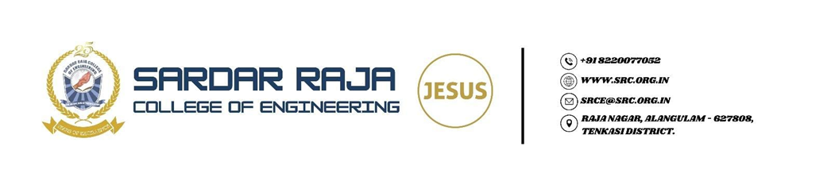
Department Of Artificial Intelligence & Data Science
AI-Powered Intelligent Software Development Assistant Using LLM
Guide name :
Prof. N.Sindhu AP/AI&DS
TEAM MEMBERS:
M.Adlin Mercy - 952723243002
A.Anusuya - 952723243005
M.Mahalakshmi - 952723243017

Slide 2
ABSTRACT
The proposed project, "AI-Powered Intelligent Software Development Assistant Using LLM," aims to assist developers throughout the software development process. The system uses AI to analyze software requirements, generate code, detect and debug errors, explain code, review code quality, and generate technical documentation. By integrating these features into a single platform, the proposed solution reduces development time, improves code quality, and enhances developer productivity. The project is inspired by recent research on trustworthy AI software development assistants and extends it by providing a practical AI-powered development environment for modern software engineering.

Slide 3
SYSTEM REQUIREMENTS
Hardware
Processor: Intel i3/i5 or above
RAM: 4 GB minimum (8 GB recommended)
Storage: 256 GB or above
Internet Connection

Slide 4
SYSTEM REQUIREMENTS
Software Requirements
Operating System: Windows/Linux/MacOS
Programming Language: Python
Frontend: HTML, CSS, JavaScript / React.js
Backend: Flask / FastAPI
Database: MySQL / MongoDB
Tools: VS Code, Git/GitHub, LLM API

Slide 5


